Slide 1
Overview of Never Events and Hospital Acquired Conditions in
Medicare and Medicaid
Barbara Dailey, Director
Division of Quality, Evaluation, and Health Outcomes
Family and Children’s Health Programs
Centers for Medicare & Medicaid Services
Maryland Association for Healthcare Quality
October 29, 2009

Slide 2
The Centers for Medicare &
Medicaid Services
The Centers for Medicare & Medicaid Services (CMS) is an agency within the Department of Health and Human Services (HHS). Created in 1977, CMS brought together the two largest Federal health care programs, Medicare and Medicaid under a unified leadership.
In 1997, the State Children’s Health Insurance Program (SCHIP) was established to address the health care needs of uninsured children. With a current budget of almost $293 billion and serving over 98 million total beneficiaries, CMS has become the largest purchaser of health care in the United States.

Slide 3
To Err is Human
In 1999, a landmark report by the Institute of Medicine, based upon analysis of multiple studies by a variety of organizations, estimated that as many as 98,000 deaths a year in United States hospitals were attributable to medical errors.
To Err Is Human: Building a Safer Health System; Linda T. Kohn, Janet M. Corrigan, and Molla S. Donaldson, Editors; Committee on Quality of Health Care in America, Institute of Medicine; The National Academies Press; 2000

Slide 4
To Err is Human
In 2000, CDC estimated that hospital-acquired infections added nearly $5 billion to U.S. health care costs annually
Centers for Disease Control and Prevention: Press Release, March 2000.
A 2007 non-government study found that, in 2002, 1.7 million hospital-acquired infections were associated with 99,000 deaths
Klevens et al. Estimating Health Care-Associated Infections and Deaths in U.S. Hospitals, 2002. Public Health Reports. March-April 2007. Volume 122.

Slide 5




The Right Care,
For Every Person,
Every Time

Slide 6
Value Based Care in Medicare
Under the provisions of Section 5001 (c) of the Deficit Act of 2005, Medicare announced that starting in October 2008, the Federal Government would no longer pay the extra cost of treating patients with bed sores, falls, and six other categories of preventable injuries and infections occurring during a hospitalization.

Slide 7
Never Events - The Beginning
In 2006, a collaboration between the Leapfrog Group and the National Quality Forum recommended to Congress that Medicare adopt policies to require reporting of “serious reportable” patient safety events.

Slide 8
Never Events - The Beginning
Also in 2006, the Tax Relief and Health Care Act mandated that the Office of Inspector General report to Congress regarding the incidence of “Never Events” among Medicare beneficiaries.

Slide 9
Medicaid – the Beginning
In 2007, CMS issued a State Medicaid Director Letter outlining a Value-Based Quality Initiative to address:
  Supporting Interoperable Health Information Technology,
  Transparency of Quality Information,
  Transparency of Price Information, and
  Incentives for High-Value Health Care
  BUT there were no specific reference to “Never Events”

Slide 10
Medicare – Next Steps
On July 31, 2008, the Medicare Inpatient Prospective Payment System (IPPS) 2009 Final Rule was published to update payment policies and rates for more than 3,500 hospitals that were paid under Medicare’s diagnosis related group (DRG) payment system.
This approach was designed to promote the Administration’s goal of transforming Medicare to a prudent purchaser of health care services, paying for quality of services, not just quantity.

Slide 11
Hospital Acquired Conditions
Under that Rule, CMS now included 10 categories of conditions that were selected for the Hospital Acquired Conditions payment provision:
  Foreign Object Retained After Surgery,
  Air Embolism,
  Blood Incompatibility,
  Stage III and IV Pressure Ulcers,
  Falls and Trauma,

Slide 12
Hospital Acquired Conditions
continued:
  Manifestations of Poor Glycemic Control,
  Catheter-Associated Urinary Tract Infection (UTI),
  Vascular Catheter-Associated Infection,
  Surgical Site Infection following selected procedures, and
  Deep Vein Thrombosis (DVT)/Pulmonary Embolism (PE) following Total Knee Replacement and Hip Replacement

Slide 13
Medicaid – Next Steps
Also on July 31, 2008, CMS released a Medicaid State Medical Director Letter (SMDL #08-004) to provide guidance on State Medicaid payment policies related to the Medicare program.

Slide 14
Medicaid – Next Steps
The State Medicaid Director Letter:
  Encouraged States to adopt nonpayment policies to coordinate with the Medicare Rule
  Did NOT provide a “blanket” Medicaid policy
  Did list the HAC/Never Events
  Provided guidance for States to amend/update State Medicaid Plans to include how the State would limit payment for these events, especially to prevent providers from billing Medicaid as a secondary payer (to Medicare for dual-eligible)

Slide 15
STATE Medicaid Initiatives
In response to that guidance, and a published list of nationally recognized never events by the National Quality Forum, some States began to initiate or pass legislation to address Never Events and Hospital Acquired conditions specific to their State Medicaid programs.

Slide 16
State Medicaid Initiatives
As of July, 2009, the following six States have explicitly addressed Never Events in their State Medicaid Plan: NE (12/08), KS (01/09), UT (03/09), NJ (05/09), WI (06/09), and IN (06/09).
At least five other states have State Plan amendment requests under CMS review to address Never Events.

Slide 17
Office of Inspector General
In December 2008, the Office of the Inspector General released the first set of three reports on “Adverse Events”, expanding on the Congressional mandate to study “Never Events”

Slide 18
Office of Inspector General
Adverse Events in Hospitals: Overview of Key Issues oig.hhs.gov/oei/reports/oei-06-07-00470.pdf
Adverse Events in Hospitals: State Reporting Systems oig.hhs.gov/oei/reports/oei-06-07-00471.pdf
Adverse Events in Hospitals: Case Study of Incidence Among Medicare Beneficiaries in Two Selected Counties oig.hhs.gov/oei/reports/oei-06-08-00220.pdf

Slide 19

Patient Safety Remains a Priority
For the President, the Secretary of Health, the Federal Government, State Medicaid Programs ….

Slide 20
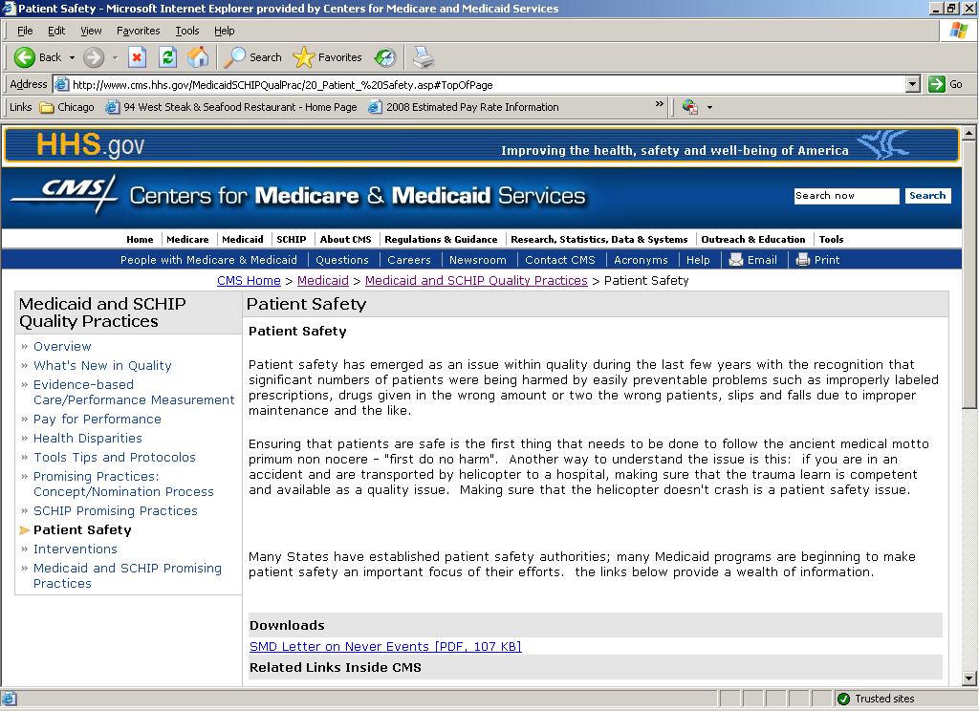
http://www.cms.hhs.gov/MedicaidCHIPQualPrac/20Patient%20Safety.asp

Slide 21

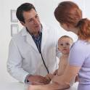
  The Right Care
  For Every Person
  Every Time

